Slide 1
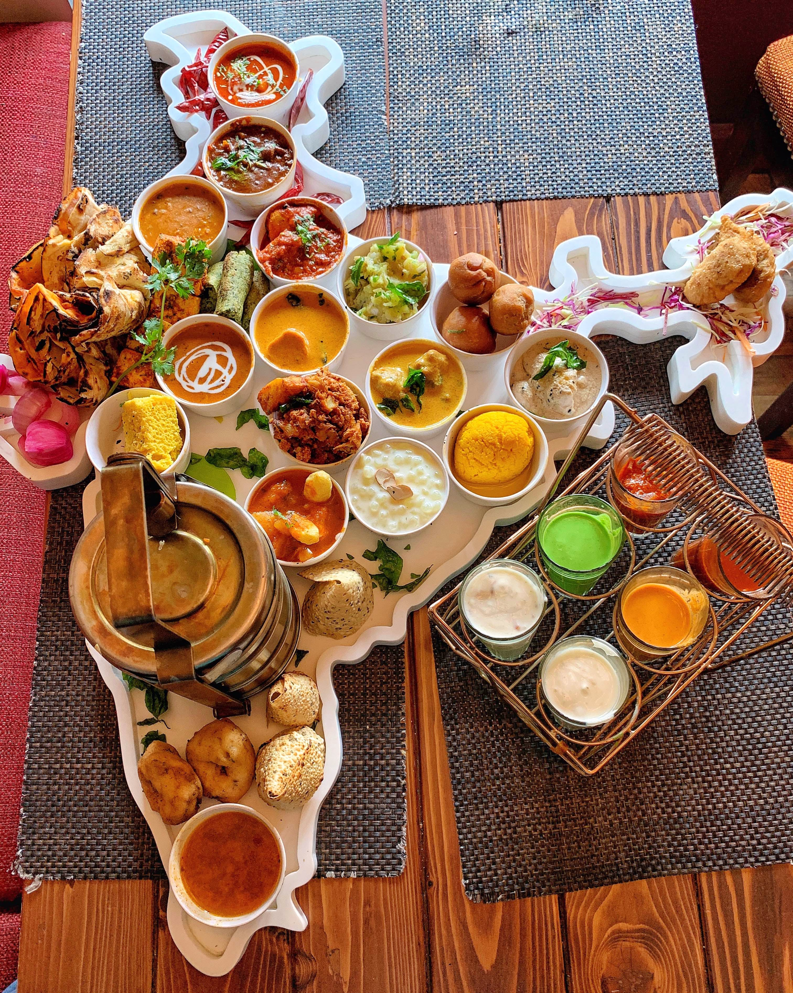
Food Delivery Service in Manhattan
Coursera/IBM Capstone Project Presentation

Slide 2
Problem Statement
I have been approached by a Manhattan based businessman who wants to start a service which delivers Indian food to a customer’s home. He believes the demand for his service will be higher in neighborhoods of Manhattan where there is a lack of Indian restaurants. He has asked me to help him identify such neighborhoods so that he can better target his marketing budget.

Slide 3
Data Acquisition
Latitude/Longitude of NYC neighborhoods – I sourced this information from the JSON file made available by the IBM team for the Coursera Capstone project.
Information on Indian Restaurants – I sourced this information from Foursquare. I used their ‘Search’ API endpoint for this project. This endpoint can be used to return a list of venues near a given location based on a keyword based query or by specifying the category ids of interest. I used the latitude and longitude of the neighborhoods to search for the number of Indian restaurants in a 500 meter radius around them. I used the Category Id ‘4bf58dd8d48988d10f941735’ to identify Indian restaurants.
Sample Data
Neighborhood | Latitude | Longitude | Number of Indian Restaurants
Marble Hill | 40.876551 | -73.910660 | 1
Chinatown | 40.715618 | -73.994279 | 4
Washington Heights | 40.851903 | -73.936900 | 2
Inwood | 40.867684 | -73.921210 | 0
Hamilton Heights | 40.823604 | -73.949688 | 2

Slide 4
Methodology
Clustering - The first step was to run Clustering on this dataset. I used the K-means clustering algorithm. I split the dataset into 3 clusters based on the number of restaurants in the neighborhood. The idea is to identify three groups of neighborhoods differentiated by the number of Indian restaurants around them.
Visualization - The second step was to visualize the results on a map to easily identify clusters of neighborhoods with few Indian restaurants as requested by the client. The Folium library was used for this.

Slide 5
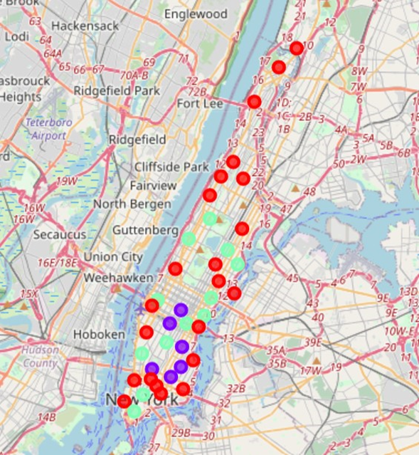
Final Recommendation
The three clusters that were created had the following characteristics –
Cluster 0 has 22 neighborhoods. These neighborhoods have 0 to 6 Indian Restaurants.
Cluster 2 has 12 neighborhoods. These neighborhoods have 7 to 16 Indian Restaurants.
Cluster 1 has 6 neighborhoods. These neighborhoods have 21 to 28 Indian Restaurants.
The map of Manhattan showing the three clusters is shown on this slide. My recommendation to the businessman would be to target the seven neighborhoods in Manhattan north of Central Park (highlighted in the map below using a blue circle). They are geographically contiguous and all have a low density of Indian restaurants. His service will be an attractive proposition for residents of these neighborhoods who enjoy Indian food.

